Slide 1

Packages Document Control System
(Quality Management System)

Slide 2

What is a Document?
Communication of information
Evidence of conformity
Knowledge sharing
Paper
Electronic
Photographic
Master Sample
Other
Notes:
2

Slide 3
Definition (1 of 3)
DOCUMENT CONTROL:
Document control means that the right persons have the current version of the documents they need, while unauthorized persons are prevented from use.
CONTROLLED DOCUMENTS
Documents, which require proper authorization/ approval from relevant authority. Intranet controlled documents carry a footer stating “This is a controlled document of Packages Limited”. This footer also states the issuer name and last printed date and time to comply with the sunset clause.
UNCONTROLLED DOCUMENTS
These are photocopies of controlled documents issued by the authorized persons to personnel for reference. The document will be stamped and signed by the issuing authority.
OBSOLETE DOCUMENTS:
A document is said to be Obsolete when;
A) The document is revised the old version becomes invalid or void.
B) The document is declared invalid by the document control authority.

Slide 4
Definition (2 of 3)
DOCUMENT CIRCULATION LIST:
A list carrying descriptions and numbers of all documents used currently in Packages. Document Circulation list is customized for each level.
QUALITY RECORD LIST:
List carrying all the quality records, its numbers, location and retention time. This is approved and issued by departmental manager.
COMMON PROCEDURE
Those procedures which are applicable to all/ mostly business units and service departments under the scope of ISO 9001.
MR
Management representative (MR) is the person in charge of looking after the effective implementation of QMS.

Slide 5
Definition (3 of 3)
SUNSET CLAUSE
All documents if printed from their soft copies shall carry the date and time of that print. According to the Sunset Clause these documents will become void at end of that day and Packages Limited shall not be held accountable or responsible for any annotations expressed in that document.
READ ONLY:
These are rights given to user for accessing document just for the purpose of viewing. They cannot be changed, deleted or modified in any way on the intranet website.
QSP Quality System Procedure
QP Quality Plan
QR Quality Record
WI Work Instruction

Slide 6
LEVEL SYSTEM IN PACKAGES
Level 1 | Quality Manual
Level 2 | Quality System Procedures & Quality Plans.
Level 3 | Work Instructions, Job descriptions, Raw material specs, Finished product specs, Technical specs., Process specs, ISO Standards, Legislative requirements, Organogram, Release Specs, SOP , specific plans etc.
Level 4 | It includes all Quality Records and Forms
Level 1 & 2 (Responsibility) | Management Representative / DMR
Level 3 & 4 (Responsibility) | Respective Department Managers & DIV/Business Unit Managers

Slide 7
DOCUMENT APPROVAL
MD/GM approve level 1 documents
MR /HOD approve level 2 documents
Departmental Manager approve level 3 documents
Document date is approval date
Document numbering should be according to WI for Document Numbering “WIQA/4.2.3/01”.

Slide 8
Document change & issuance
For Level 1 & 2
MR takes approval for level 1
If manager have intention to change in level 2, he should inform MR
MR kept original signed revised copy as reference
Upload soft copy on intranet (172.16.1.44)
Old version taken back from intranet
No issuance is required in hard form
Uploading done within one week of receiving
MR send the notification of new uploading through email (C-List) as per requirement.

Slide 9
Document issuance
For Level 3 & 4
Level 3 controlling and issuance is done by departmental head
Document issuance record is also maintained
DCL is prepared by manager (representative) and send/issue copy to MR
Document operative date is date when it is issued according to DCL
Old document is stamped obsolete.
File up obsolete documents in separate file till retention period.
Temporary instruction ---- Manager can issue for display,
not need to be stamped controlled
issuance record not mandatory

Slide 10
ISSUANCE OF CONTROLLED DOCUMENTS
For Level 3
Stamped Issued
To whom issued
Date & Signature of issuing authority
It’s responsibility of relevant manager to maintain the record of issuance of controlled documents as per DCL.
When a document is issued from one department to another department and the department (To whom it was issued) have to use the same document in different areas then that department will internally copy the issued document, sign with name & date at front page of each copy and distribute it for use. That distributing department will also maintain its distribution record and when its revised issued copy received (from document custodian department); the previously internally distributed (obsolete) signed copies will be collected from all areas and disposed off.
Note: No issuance is required in hard for level 1 & 2 documents

Slide 11
Identification of changes
All changes would be in BOLD letters
In case of changes in header/footer, no need for next revision (unless document number is changed)
Document should reviewed from time to time to ensure their effectiveness
Document can revised as the result of :
* change in process
* corrective action raised during internal audit

Slide 12
Document Format
Standard format -- font size 12 --Times New Roman -- A4 size paper
Header (for all levels)
PACKAGES LIMITED | Document type QUALITY SYSTEM PROCEDURE ___________________________________________ Title COMPLAINT MANAGEMENT PROCEDURE
Prepared by DMR | Approved by MR | PAGE 1(4) | REV 1 | DATE 29/1/20132 | DOC NO. QSPQA/7.2.3/02
End of Document
Footer (for level 1&2 only)
. This is a controlled document of Packages Limited.
Last printed 02/15/11 11:43:00 AM(SSC Applied) Issued By: MR/DMR

Slide 13
External document
Control of record
Stamped controlled
Distribution according to Document Circulation List
On revision, old copies stamped obsolete
If any standard extracted from book, that should also be reviewed and stamped obsolete (if required)
Identification
Storage
Protection
Index
Retrieval
Retention
Legible
Prepare a Quality Records List having retention period of records and send copy of Quality Record List to MR

Slide 14
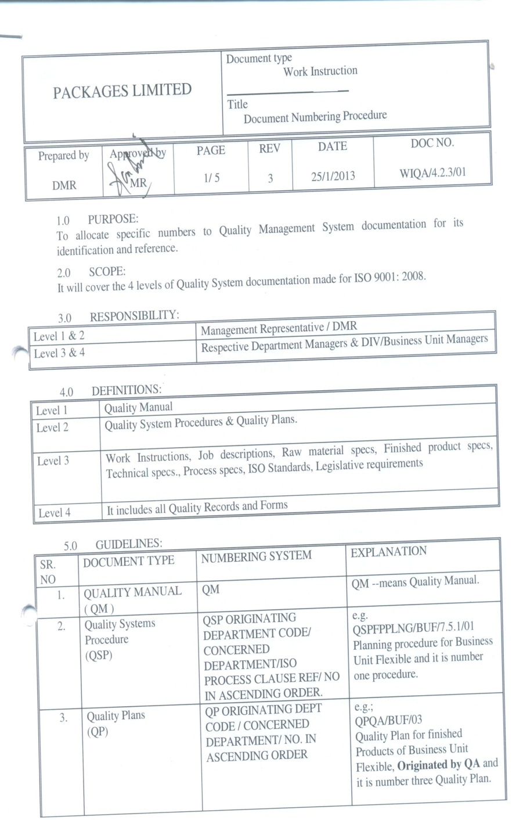
Control Document

Slide 15
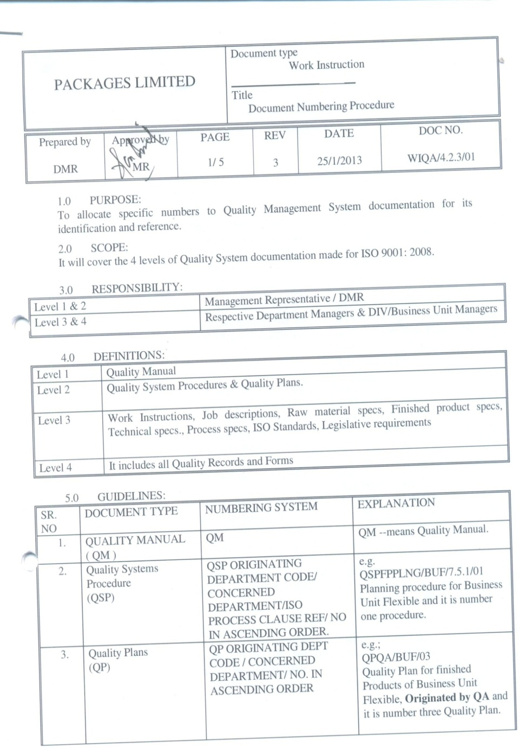

COPY
Issued Document

Slide 16

COPY
Further use of Issued Document
Name & Signature with date

Slide 17
Amendment history
REV # | DATE | PART/ SECTION | NATURE OF AMENDMENT | DONE BY
1 | September 2013 | Section 4, 5, 7.1, 7.2, 7.3, 7.6 & 7.7 | Simplifying the control and issuance system and improve effectiveness of procedure. | Asadullah Khan

Slide 18
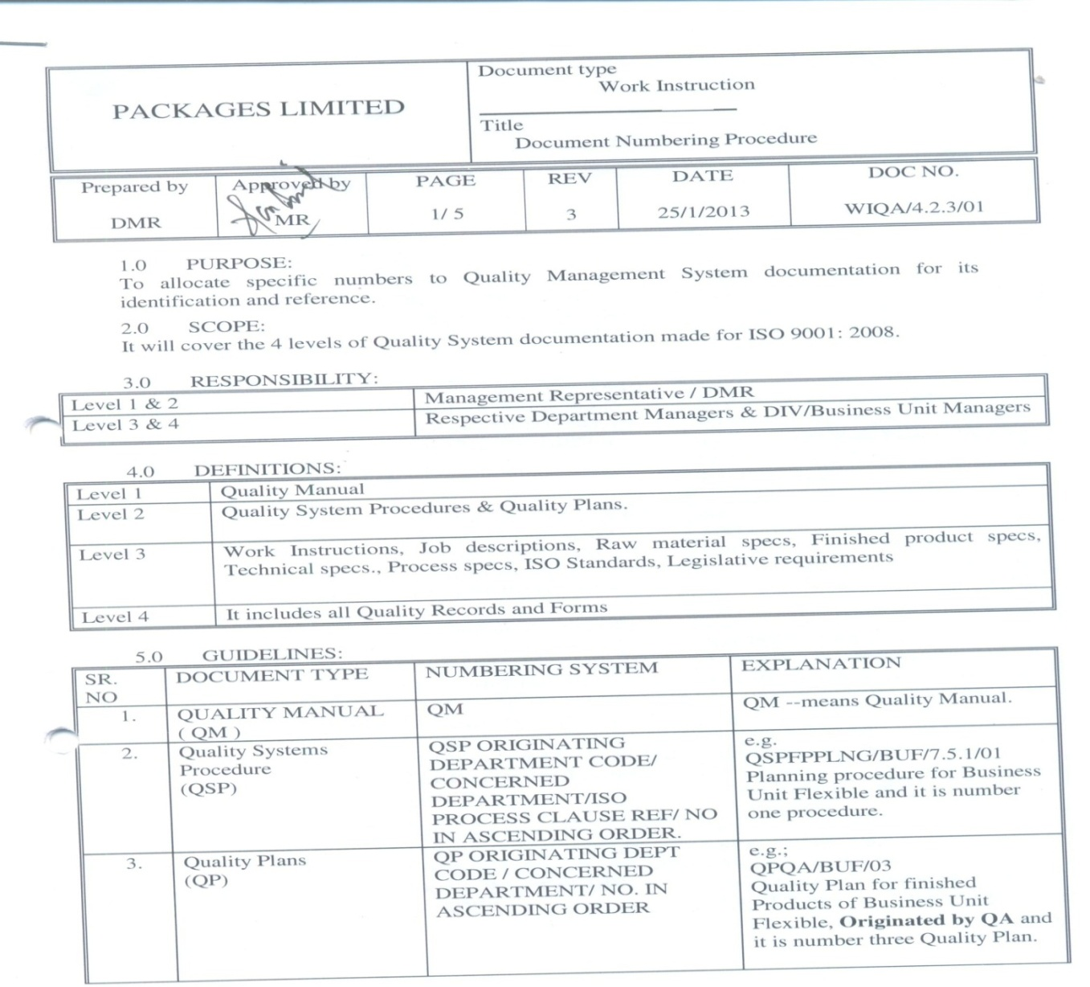
Properly dispose off (IF NOT REQUIRED)
Obsolete Documents
2

Slide 19
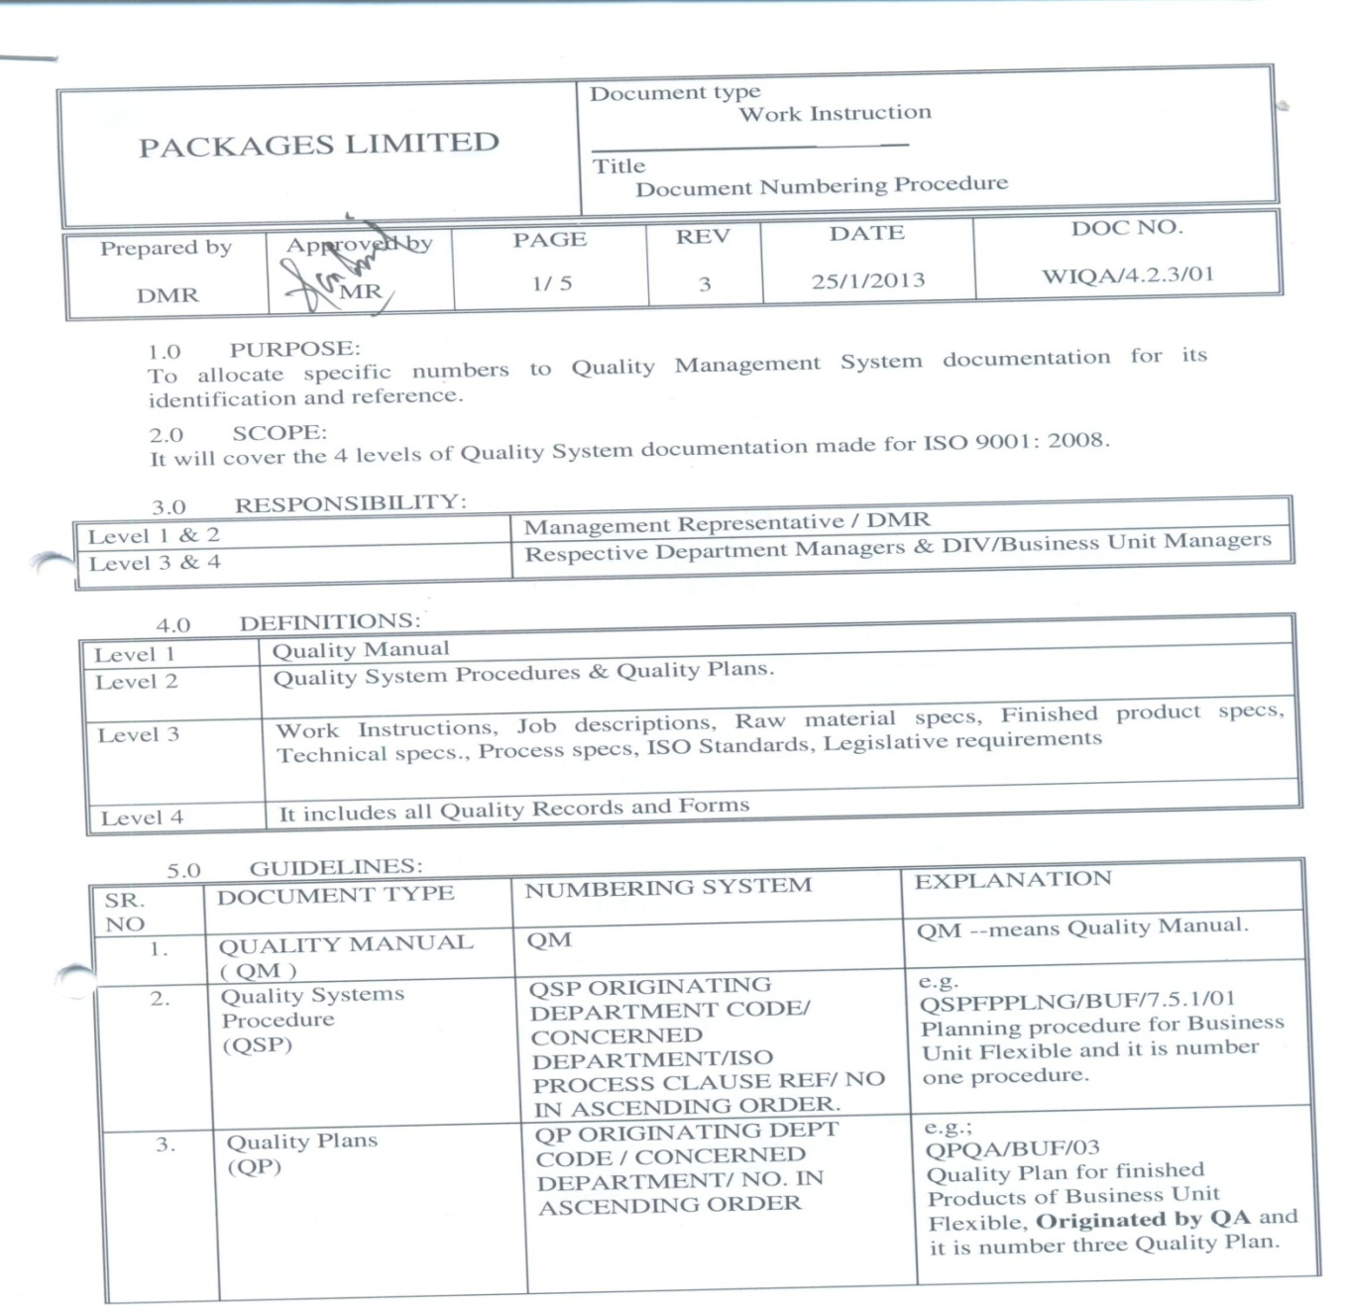

Keep in a separate file after stamping obsolete (IF REQUIRED)
2

Slide 20
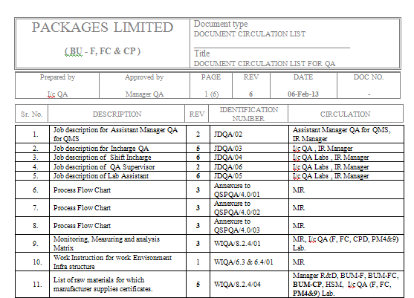
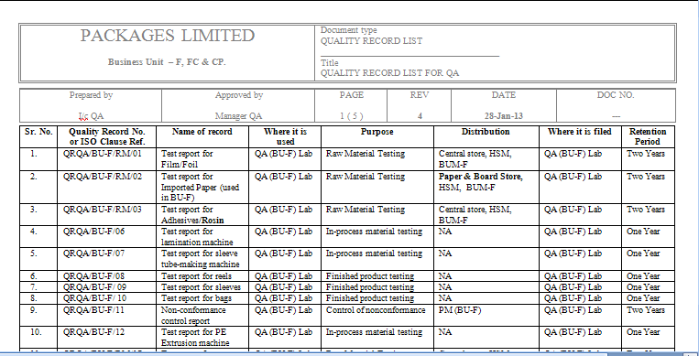
Document Circulation List
Quality Record List
DCL/QA/01
QRL/QA/01
5.13 | DOCUMENT CIRCULATED LIST (DCL) | DCL ORIGINATING DEPT CODE / CONCERNED DEPARTMENT / NO. IN ASCENDING ORDER | e.g. DCL/TCONV/BUCP/01 Means that Document Circulation List of Tissue Conversion of Business Unit Consumer Products and it is number one document
5.14 | QUALITY RECORD LIST (QRL) | QRL ORIGINATING DEPT CODE / CONCERNED DEPARTMENT / NO. IN ASCENDING ORDER | e.g. QRL/TCONV/BUCP/01 Means that Quality Record List of Tissue Conversion of Business Unit Consumer Products and it is number one document

Slide 21

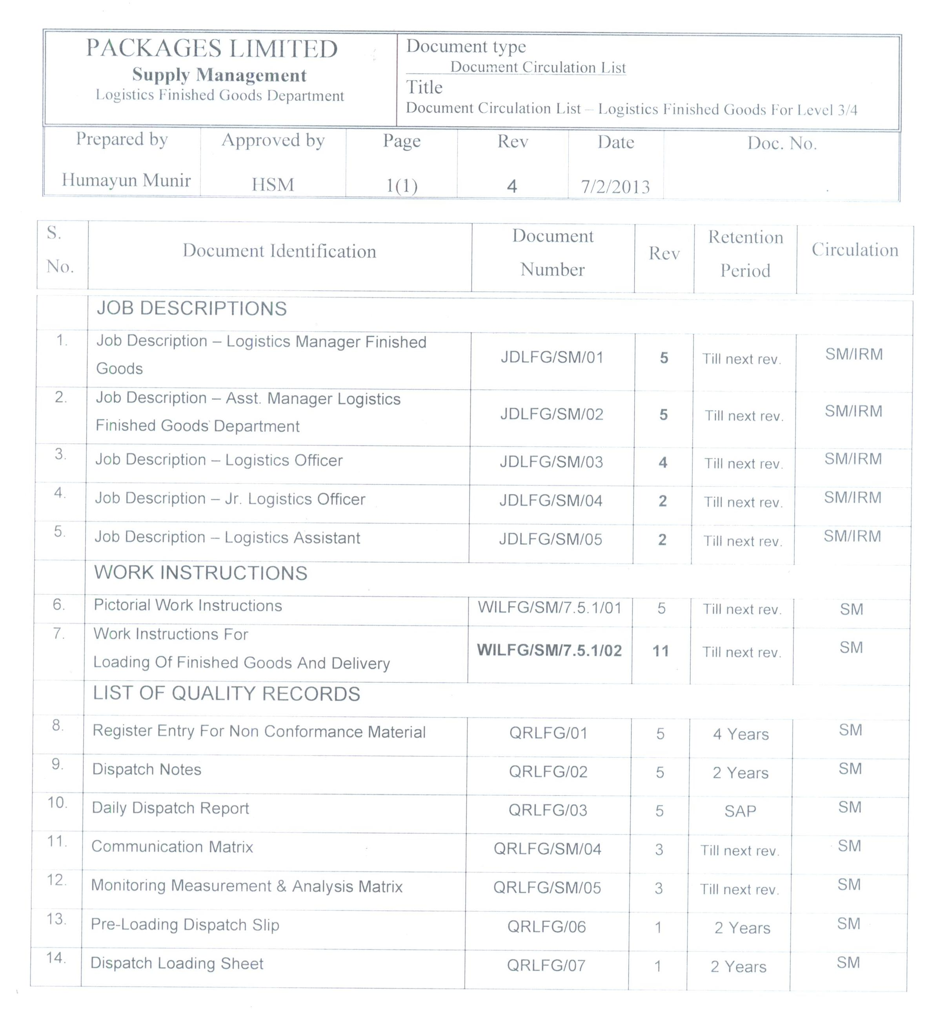
Document Circulation List
DCL/LFG/SM/01

Slide 22
Important notes for document numbering
. NOTE 2: FOR LEVEL TWO DOCUMENTS THE ASCENDING, ORDER NUMBER IS WITH RESPECT TO THE ISO 9001-2008 PROCESS CLAUSE REFERENCE.
NOTE 3: FOR LEVEL THREE DOCUMENTS THE ASCENDING, ORDER NUMBER IS WITH RESPECT TO THE DEPARTMENT NUMBER OF RECORDS REFERENCE.
NOTE 4: THE DOCUMENT NUMBER OF THE QUALITY RECORDS SHALL BE WRITTEN ON THE FORM. For Example
QUALITY ASSURANCE (BU-F.: 6) Rev. Date: 11.02.11
NON-CONFORMANCE CONTROL REPORT Rev. No
ATTENTION : PM (BU-F) QRQA/BU-F/11
NOTE 5: THE FLOWCHARTS CAN BE NUMBERED AS FC OR FLOWCHART FOR SPECIFIC PLACE/ DEPARTMENT FOR EXMAPLE: FLOWCHART FOR BUF OR FC-BUF. Rev. No Rev Date:
NOTE 5: THE ORGANOGRAM CAN BE NUMBERED AS ORG OR ORGANOGRAM FOR SPECIFIC DEPARTMENT FOR EXMAPLE: ORGANOGRAM FOR QA OR ORG-QA. Rev. No Rev Date:

Slide 23
Thanks

