Slide 1


Employee Engagement Survey 2019
Packages Group
General Guide & Instructions

Slide 2


































































Slide 3



















Slide 4
































Slide 5































Slide 6








































































































•
–
–
–
–
•
•
•
•
•

Slide 7





















Slide 8







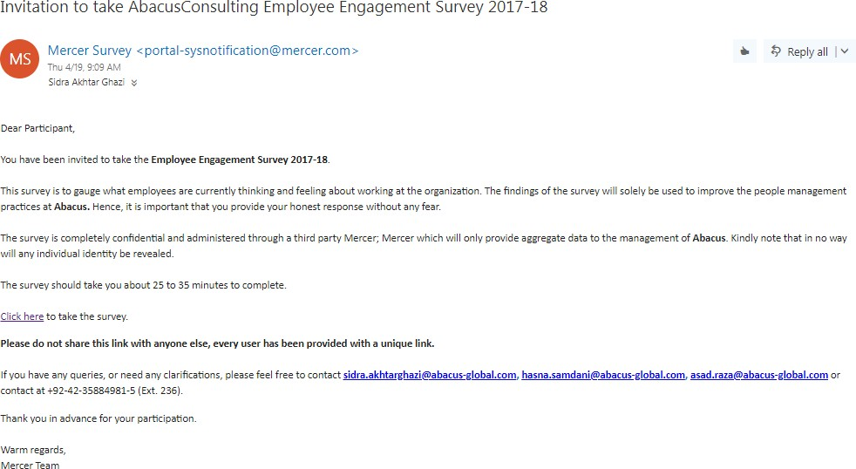










Click Here

Slide 9


















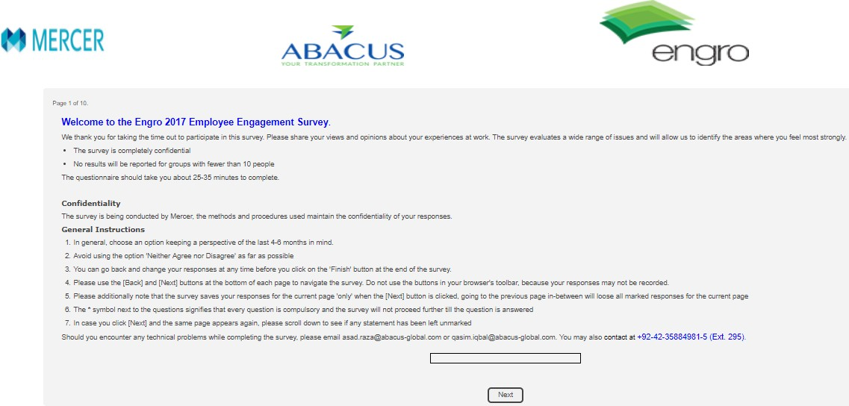


Welcome to the Packages Group 2019 Employee Engagement Survey
If you have any queries, or need any clarification, please feel free to contact asad.raza@abacus-global.com and sidra.akhtarghazi@abacus-global.com or contact at +92-42-35884981-5 (Ext. 236)

Slide 10




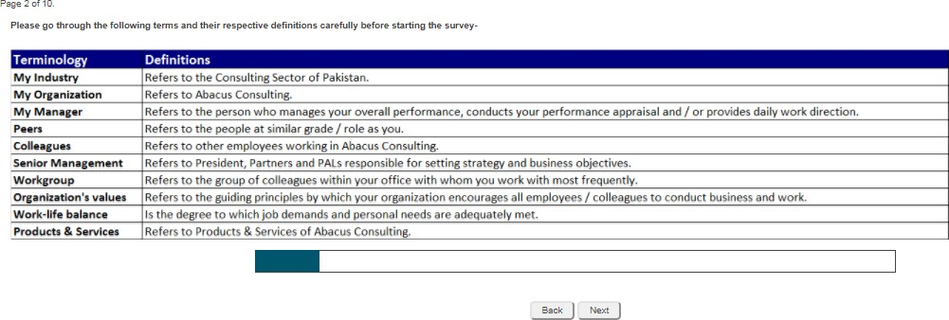





















Slide 11









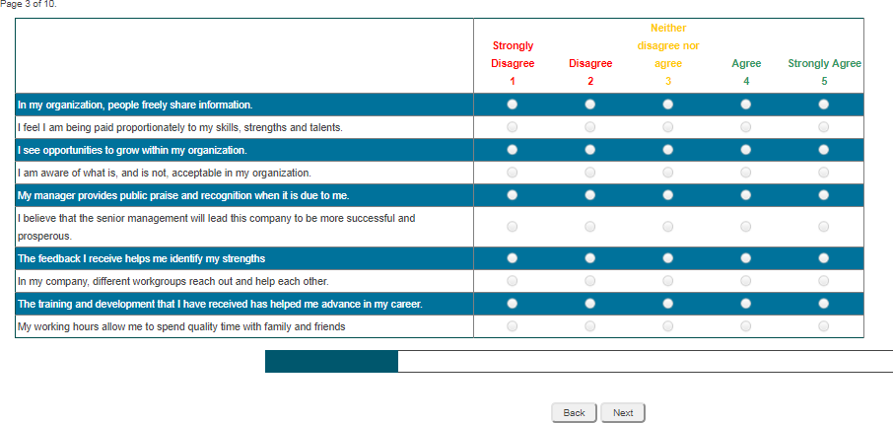


Slide 12
























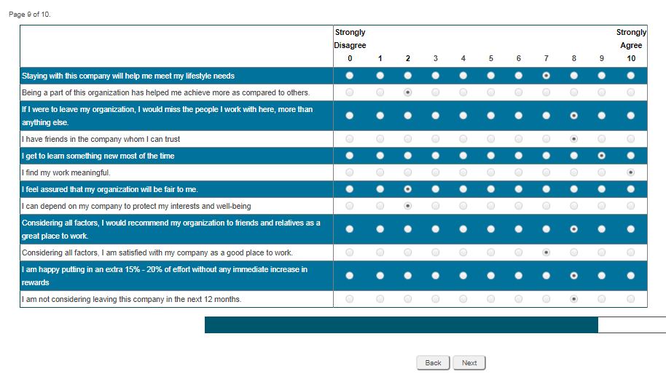

Slide 13

























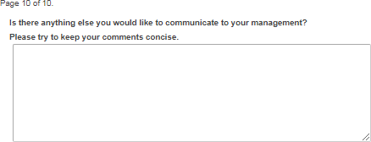


Slide 14













Slide 15
















































Slide 16




We guarantee 100% confidentiality of your survey feedback due to engagement of third party

